Slide 1
ECE 411 Spring 2016 Lecture 9
Branch Prediction

Slide 2
Types of Branches

Slide 3
Static Branch Prediction
Uni-directional, always predict taken (or not taken)
Backward taken, Forward not taken
Need offset information (when?)
Compiler hints with branch annotation
When the info will be available? Post-decode?

Slide 4
Why branches are predictrable?
Correlation
B1: if (x)
...
B2: if (y)
...
z=x&&y
B3: if (z)
...
B3 can be predicted with 100% accuracy based on the outcomes of B1 and B2

Slide 5
Patterns for all three branches
000, 100, 010, 111
00 à 0
01 à 0
10 à 0
11 à 1
If the history is 000 100 010 11
What is the prediction?

Slide 6
Simplest Dynamic Branch Predictor
Prediction based on latest outcome
Index by some bits in the branch PC
Aliasing
NT
1-bit
Branch
History
Table
T
T
for (i=0; i<100; i++) {
….
}
NT
T
0x40010100
0x40010104
0x40010108
…
0x40010A04
0x40010A08
addi r10, r0, 100
addi r1, r1, r0
L1:
… …
… …
addi r1, r1, 1
bne r1, r10, L1
… …
.
.
.
T
NT
NT
How accurate?

Slide 7
FSM of the Simplest Predictor
A 2-state machine
Change mind fast
0
1
If branch taken
If branch not taken
0
Predict not taken
1
Predict taken

Slide 8
Example using 1-bit branch history table
addi r10, r0, 4
addi r1, r1, r0
L1:
… …
addi r1, r1, 1
bne r1, r10, L1
for (i=0; i<4; i++) {
….
}

√
√
√


√
√
√


Pred
0
1
1
1
1
0
1
1
1
1
0
1
Actual
T
T
T
T
NT
T
T
T
T
NT
T
60% accuracy

Slide 9
2-bit Saturating Up/Down Counter Predictor
MSB: Direction bit
LSB: Hysteresis bit
10/
WT
11/
ST
01/
WN
00/
SN
Taken
Not Taken
ST: Strongly Taken
WT: Weakly Taken
WN: Weakly Not Taken
SN: Strongly Not Taken
Predict Not taken
Predict taken

Slide 10
Example using 2-bit up/down counter
addi r10, r0, 4
addi r1, r1, r0
L1:
… …
addi r1, r1, 1
bne r1, r10, L1
for (i=0; i<4; i++) {
….
}

√
√
√

√
√
√

√
√
Pred
01
10
11
11
11
10
11
11
11
11
10
1
Actual
T
T
T
T
NT
T
T
T
T
NT
T
80% accuracy

Slide 11
Typical Table Organization
PC (32 bits)
Hash
2^{N} entries
.
.
.
.
.
N bits
table update
FSM
Update
Logic
Actual outcome
Prediction

Slide 12
Simplest Dynamic Branch Predictor
for (i=0; i<100; i++) {
if (a[i] == 0) {
…
}
…
}
NT
1-bit
Branch
History
Table
T
T
0x40010100
0x40010104
0x40010108
0x4001010c
0x40010110
0x40010210
0x40010B0c
0x40010B10
addi r10, r0, 100
addi r1, r1, r0
L1:
add r21, r20, r1
lw r2, (r21)
beq r2, r0, L2
… …
j L3
L2:
… … …
L3:
addi r1, r1, 1
bne r1, r10, L1
NT
T
.
.
.
T
NT
NT

Slide 13
Special Branches
Procedure calls and returns
Calls are always taken
Return address almost always known
Return Address Stack (RAS)
On a procedure call, push the address of the instruction after the call onto the stack

Slide 14
Types of Branches

Slide 15
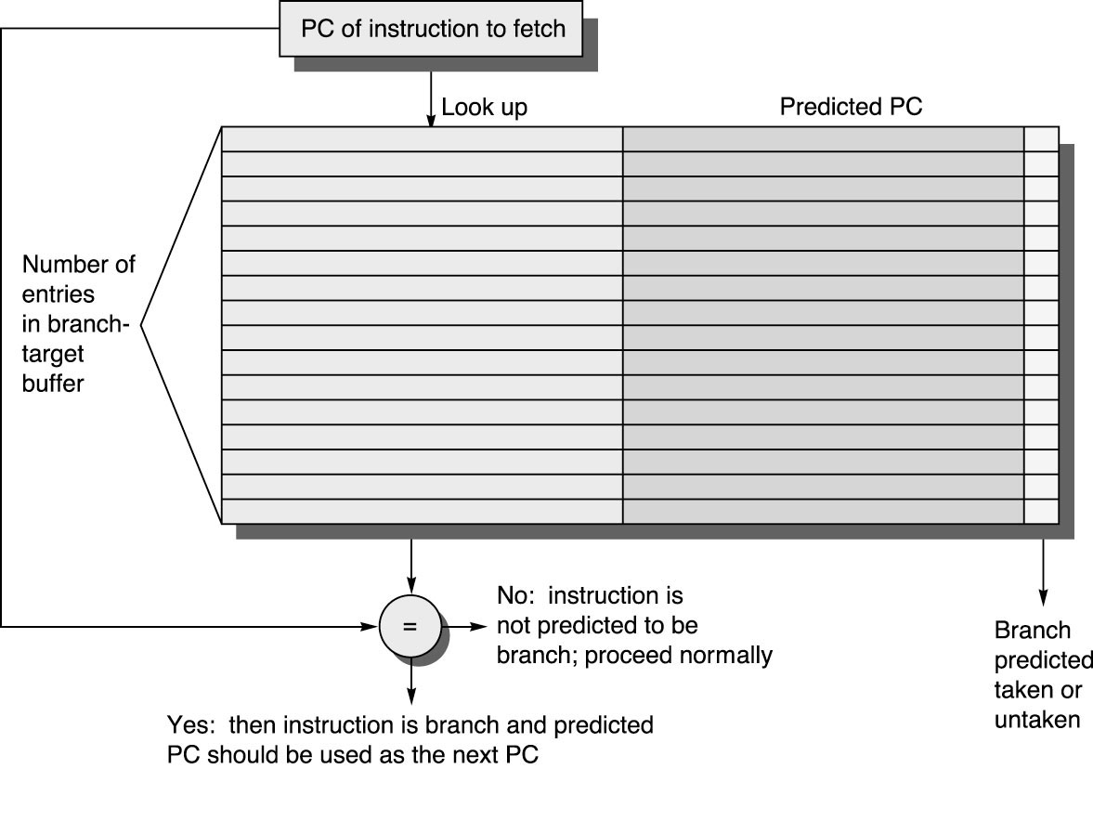
Branch Target Buffers
Predict the location of branches in the instruction stream
Predict the destination of branches

Slide 16
BTB Operation
Use PC (all bits) for lookup
Match implies this is a branch
If match and predict bits: taken, set PC to predicted PC
If branch predict wrong: must recover (same as branch hazards we’ve already seen)
If decode indicates branch w/ no BTB match, two choices:
look up prediction now and act on it
just predict not taken
When branch resolved, update BTB (at least prediction bits, maybe more)

Slide 17
BTB Performance
Two things that can go wrong
Didn’t predict the branch (misfetch)
Mispredicted a branch (mispredict)
Suppose BTB hit rate of 85% and predict accuracy of 90%, misfetch penalty of 2 cycles and mispredict penalty of 10 cycles, what is average branch penalty?
Can use both BTB and branch predictor
Have no prediction bits in BTB (why is that a good idea?)
Presence of PC in BTB indicates a lookup in branch predictor to predict whether the branch will go to destination address in BTB

Slide 18
Types of Branches

Slide 19
What about indirect jumps/returns?
Branch predictor does really well with conditional jumps
BTB does really well with unconditional jumps (jump, jal, etc.)
Indirect jumps often jump to different destinations, even from the same instruction. Indirect jumps most often used for return instructions.
Return easily handled by a stack.
jal -> push PC+4
return -> predict jump to address on top of stack, pop stack

Slide 20
Instruction Fetch Stage
Branch
Execution
Address
MUX
PHT
Hit/miss
Next PC Logic
T/NT
Branch
Execution
T/NT
PC
BTB
+ 4
Instruction Memory (i-Cache)

Slide 21
Update PHT and BTB (Prediction Miss)
MUX
PHT
PC
BTB
Branch PC
Target PC
Instruction Memory (i-Cache)

